Slide 1
Trading cards
A template for students to complete digital trading cards about famous people or places in reference to a particular topic.

Slide 2
Directions
Each slide is set up with a spot for different types of content. Use the slide template that makes sense for your project.
Make sure you set up your presentation for success with a Title or Lead card that sets up your cards for your audience.

Slide 3
Title slide

Slide 4
PUT THE PERSON/ PLACE NAME HERE
Add a description of the person or place here.
Your description should be in your own words.
You should also add a caption for the image.
A caption should have all the information about the picture, be accurate and interesting. Identify the main person in the photo. Be specific and make sure it is labeled correctly. Always include credits and citations as well.
Use the box to the right to add your image
<Insert caption here>

Slide 5
Use this slide if you need more content
You can add a brief description here
Add more information here as needed

Slide 6
Ending slide
Put your last thoughts or wrap up here

Slide 7
Who’s who in the Civil Rights Movement
This is an example

Slide 8
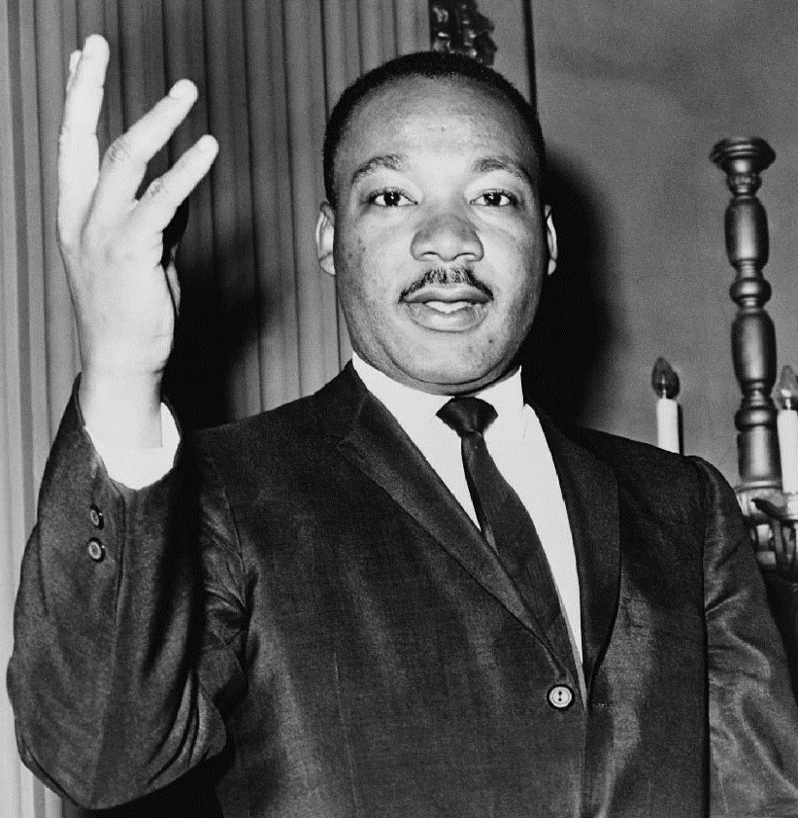
Martin Luther King, Jr.
1929-1968
Pastor Dexter Avenue Baptist Church
Voting rights campaign
Non-violent leader of the civil rights movement
Assassinated 1968
Famous speech “I Have a Dream”
Posthumously awarded the Presidential Medal of Freedom and the Congressional Gold Medal
Martin Luther King, Jr. Day was established as a holiday in numerous cities and states beginning in 1971, and as a U.S. federal holiday in 1986.

Slide 9
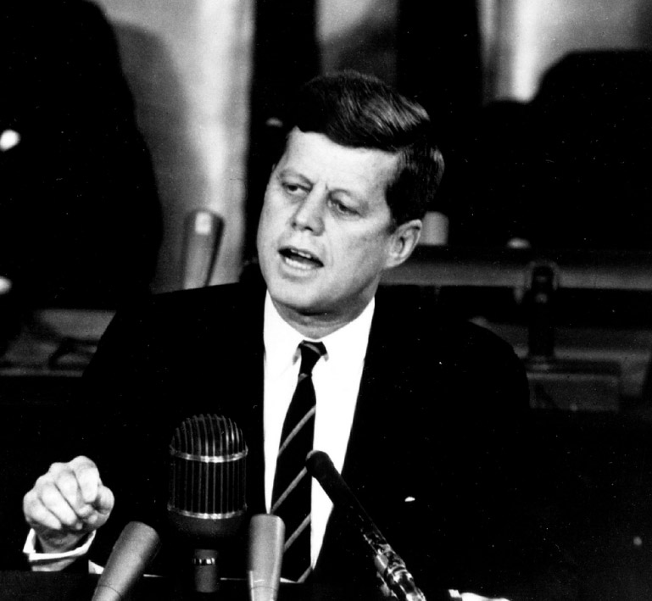
John F. Kennedy
1917-1963
President of the United States, 1961-1963
Champion of freedom
Strong supporter of civil rights
Assassinated 1963

Slide 10
Ending slide 2
Put your last thoughts or wrap up here

Slide 11
Customize this Template
Template Editing Instructions and Feedback

